Slide 1
Azure Hybrid & Azure Arc Roadmap
22H2 and 23H1

Slide 2
Objective
This deck shares a one-year roadmap for Azure Hybrid, Multicloud and Edge. We’ve also included a slide that shows the vision for long-term product innovation.

Slide 3
The need for a hybrid and multicloud platform
The need for a hybrid and multicloud platform
93%
of enterprises are committed to a hybrid cloud strategy
ESG - Hybrid Cloud Trends

Slide 4

Azure Overview 1
Security, operations, and governance
Azure services
Cloud infrastructure
Tools and experiences
Notes:
As we think about Azure and the cloud, it’s important to frame that the cloud is both an architecture and an operation model. Azure is a resilient, scalable platform for your workloads, new services to build apps – all topped with a set of management and operations solutions. At the same time, innovation should not be restricted just to the public cloud. You may have regulations to comply with, specific application latency requirements or simply a need to keep up with competition – whichever your reason, it’s clear that hybrid deployments are here to stay. You’re going to run workloads in the cloud, and outside of public cloud datacenters. But you still want access to all the benefits the cloud provides.

Slide 5



Azure Overview 2 with Azure Arc
Security, operations, and governance
Tools and experiences
Azure services
Azure Arc-enabled services
Azure Arc
Cloud infrastructure
Azure Arc-enabled infrastructure + devices
Innovate anywhere
Notes:
We wanted to bring the value cloud operations and architecture to any infrastructure, which makes your cloud to edge ecosystem simple, flexible, and secure. This is why we built Azure Arc.
Azure Arc is a bridge that extends the Azure platform so you can build applications and services with the flexibility to run across datacenters, edge, and multicloud environments.
Azure Arc provides a consistent development, operations, and security model for both new and existing applications. You use the same tools, the same security and governance technologies to create and manage application resources.
Just like in our datacenters, a subset of Azure services for application, data, and AI are there to use on both new and existing hardware, virtualization, and Kubernetes platforms, IoT devices, and integrated systems.
We’re committed to enabling companies to grow and transform themselves through technology, paving the way for rapid innovation through applications and cost savings across their businesses – independent of who built or owns the facilities and hardware.

Slide 6
Azure Overview from Cloud to the Edge 1
Security, operations, and governance
Tools and experiences
Azure services
Azure Arc-enabled services
Azure Arc
Cloud infrastructure
Azure Arc-enabled infrastructure + devices
Innovate anywhere
Cloud regions
Regional edge
IT edge
IoT edge
60+ Azure regions
Multicloud
Operator DC
Co-Lo provider
Customer DC
Branch office
Factory floor
Retail store
Field production
Notes:
Our team has been hard at work – talking with customers like yourselves, listening to your feedback, and breaking new ground to help you take advantage of the opportunity at the edge.
Our goal is to simplify the complexity you face when building the applications and services you use to run your business across cloud and edge. We do this by standardizing the way applications are built, deployed and managed, with a common set of tools and experiences. You can be confident investing in Azure knowing that if your regulations change, competition changes, whether you’re using existing or new infrastructure changes, whatever the reason, you can scale and extend your investments to wherever they are needed.
As we work with customers, we see a wide range of ways they want to architect their applications as well as places where they want to run applications, each with their own unique characteristics and requirements.
For some customers the issue is scale, they might need the hyper scale of our Azure regions. Other customers may have latency requirements for workloads that have to run in a factory floor. Others might need to meet data sovereignty needs through their existing datacenters.
That’s why we’re working to bring the Azure platform to all of those places in a way that can meet a broad ranges of requirements, and infrastructure for those applications to run on.

Slide 7

Azure overview from Cloud to the Edge 2
Security, operations, and governance
Tools and experiences
Azure services
Azure Arc-enabled services
Azure Arc
Cloud infrastructure
Azure Arc-enabled infrastructure + devices
Innovate anywhere
Azure regions
Azure perimeter
IT edge
IoT edge
60+ Azure regions
Multicloud
Public MEC
VMware
Azure Stack HCI
Private MEC
Gateways Industrial equipment POS, Kiosks, Signs

Slide 8
Azure Roadmap Taxonomy​
Private Preview invitation only, not publicly announced.
Public Preview for early adoption, limited production use, may not be available to all the customers in a region, excluded from SLA. ​
GA (Generally Available) for production use, to all customers in a region, starting to rollout to multiple regions, backed by SLA.

Slide 9







Areas of Investments
Develop cloud native, operate anywhere
Harness data insights from cloud to edge
Secure and govern across environments
Flexibly meet regulatory and connectivity needs
Notes:
Write Once Run Anywhere
Simplified and faster application lifecycle
Modernize apps to cloud-native and containers
DevOps at scale
Real Time Insights
Cloud efficiencies and automations
Consistent data & AI management
Faster time to insights
Centrally Govern
Threat detection, response and analytics
Apps, data, and infra governance
Policy driven compliance
Customize for Regulation and Connectivity
Multiple isolation and sovereignty levels
Intermittent and disconnected
Ultra-low latency applications

Slide 10












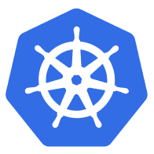


Definition of Azure Arc-enabled
With Azure Arc-enabled services and solutions, you can expect:
Inventory and organization from Azure (ARM integration)
Development and operations tools integration (as appropriate)
Security, governance, and management capabilities (Attach services as appropriate)
Cloud-style feature updates
Cloud billing model for Azure capabilities
Optional support for disconnected scenarios
Azure Arc- enabled
Azure Arc-enabled services and infrastructure
OpenShift
AWS Linux 2
Azure Stack HCI

Slide 11
Azure Arc Innovate anywhere
For customers looking to innovate anywhere:
Azure is the platform customers can use to build applications and services with the flexibility to run across datacenters, edge, and multicloud environments.
Azure Arc is the bridge that extends the Azure platform and provides a consistent development, data, operations, and security model for both new and existing applications.
Azure Arc enables the Azure platform to run on a both new and existing hardware, virtualization and Kubernetes platforms, IoT devices, and integrated systems.

Slide 12








Azure Arc
Azure Arc-enabled infrastructure
Connect and operate hybrid resources
as native Azure resources
Azure Arc-enabled services
Deploy and run Azure services outside of Azure while still operating it from Azure
Multi-cloud
Datacenter
Edge

Slide 13

Azure Arc Today
Already announced
General Availability
Arc-enabled servers | Management Services (Servers)
SQL Server on Arc-enabled servers | Azure Monitor
Arc-enabled Kubernetes | VM extensions
Azure Stack HCI | Machine Configuration
AKS on Azure Stack HCI | Azure Update Management
AKS on Windows Server | Microsoft Defender for Cloud
Arc-enabled Open Service Mesh | Microsoft Sentinel
Azure Hybrid Benefit for AKS and HCI | Azure Automation
Azure Automanage | Management Services (Kubernetes)
Data and Machine Learning Services: | Config Management (GitOps)
Arc enabled SQL Managed Instance (Business Critical) | Azure Monitor Container Insights
Arc enabled SQL Managed Instance (General Purpose)
Azure Machine Learning (Training and Inferencing)
Preview
Arc-enabled VMware vSphere | Azure App Service
Kubernetes lifecycle management for AKS-HCI | Azure Functions
Dapr extension for Arc-enabled Kubernetes | Azure Logic Apps
Azure Network Functions for operators | Azure Event Grid
AKS on Windows IoT/client | Azure API Management
Azure Update Management Center v2 | Management Services:
Data Services: | Kubernetes:
Arc enabled PostgreSQL | Azure Policy for Kubernetes
Application Services: | Microsoft Defender for Kubernetes

Slide 14
Roadmap details

Slide 15











Azure Arc-enabled infrastructure Roadmap
2022 H2 July – December
2023 H1 January – June
General Availability
Microsoft Defender for Containers | Kubernetes namespaces in the Azure Portal
Azure Key Vault secrets provider extension for Kubernetes | Automatic extension upgrades for Arc-enabled servers
Azure AD workload identity federation | Azure Automanage Machine Configuration
General Availability
Azure Private 5G Core | Arc-enabled System Center Virtual Machine Manager
Private links for Arc connected K8s | Windows Admin Center in the Azure Portal for Arc-enabled Server
Arc-enabled VMware vSphere
Preview
Windows Admin Center in the Azure Portal for Arc-enabled Server | Arc-enabled System Center Virtual Machine Manager
Private Link in AKS extensions | Defender for Cloud (AMA based) - Public Preview
Azure Private 5G Core | Arc-enabled VMware vSphere
Azure Container Registry: Connected Registry | Update management center for Arc-enabled servers
Private links for Arc connected K8s
Preview
Private Link in AKS extensions | Update management center for Arc-enabled servers
Azure Container Registry: Connected Registry | Defender for Cloud (AMA based) - Public Preview
SSH access to Azure Arc-enabled servers | Run Command for Arc-enabled servers

Slide 16






Azure Arc-enabled services Roadmap
2022 H2 July – December
2023 H1 January – June
General Availability
Data Services | Application Services
AD authentication SQL MI | Azure API Management
SQL Server 2022 with Arc built-in
​SQL Server Best Practice Analyzer (SQL BPA) for Arc-enabled SQL Server
SQL Server Best Practice Analyzer (SQL BPA)​ for Arc-enabled SQL Server
General Availability
Data Services
SQL Server Database as a Resource​ | Azure Container Apps
Arc-enabled PostgreSQL (General purpose) | Transparent data encryption (TDE) for SQL MI
Arc SQL MI Observability | Credential rotation for SQL MI
Portal and CLI Improvements
Preview
Data Services | Application Services
Unified Azure managed experiences for SQL Server | Azure App Service
Purview Integration Arc-enabled SQL Servers​ | Azure Functions
Built-in backups for Arc SQL Server​ | Azure Logic Apps
Private link support​ for Arc SQL MI | Azure Event Grid
3rd-party Key Vault Arc SQL MI
AKV key management for SQL MI
AAD authentication SQL MI
Preview
Data Services | Application Services
Arc-enabled PostgreSQL (General purpose) | Azure App Service
Arc-enabled SQL Server support for SQL Server on Linux​ | Azure Functions
SQL Server Database as a Resource​ (for Arc SQL Server) | Azure Logic Apps
Arc SQL MI Observability and insights​ | Azure Event Grid
Portal and CLI Improvements | Azure Container Apps

Slide 17
Azure Stack Run your production workloads anywhere on hybrid, familiar hyperconverged infrastructure
Azure Stack HCI is Azure inspired infrastructure that is purpose built to run Azure Arc-enabled services and can be deployed in customer environments and operated at-scale from Azure.
Azure Stack HCI is available as software that can be installed on validated nodes and integrated systems from our hardware partners.

Slide 18

Azure Stack HCI
2022 H2 July – December
2023 H1 January – June
General Availability
Tag based segmentation for SDN | Remote Support
Live migration improvements for switchless interconnects | New orchestrated deployment experience
WAC in the Azure portal | Environment readiness validators
Network ATC improvements | Increased diagnosability
Improvements to get connected, registered, and Arc-enabled | Default security improvements
General Availability
Windows Server Azure Edition on HCI (Automanage for WS VMs) | Azure Arc Jumpstart scenarios for HCI
Custom image upload for VM self-service | Arc-enabled guest management
Azure Marketplace for VM self-service | Enhanced monitoring
Preview
GPU-P with Live Migration | AD-less live migration
Trusted Launch | Easier proxy config
ReFS deduplication | Switchless support in Network ATC
Trusted VM live migration | OOBE wizard (guided SConfig)
Azure Benefits without virtual switch | Global Device ID for ring-based flighting
AVD on Azure Stack HCI | Arc-enabled VM self-service
Azure Migrate from Hyper-V to HCI
Preview
Windows Server Azure Edition on HCI (Automanage for WS VMs) | Custom image upload for VM self-service
Azure Migrate from Hyper-V to HCI | Azure Arc Jumpstart scenarios for HCI
Azure Marketplace for VM self-service | Enhanced monitoring
Arc-enabled guest management | Arc-enabled VM self-service
AVD on Azure Stack HCI

Slide 19
AKS hybrid Deploy and manage containerized apps with AKS on-premises
AKS hybrid deployment options simplifies managing, deploying and maintaining a Kubernetes cluster on-premises, making it quicker to get started hosting Linux and Windows containers in your datacenter.

Slide 20







Azure Kubernetes Service – AKS hybrid
2022 H2 July – December
2023 H1 January – June
General Availability
Windows Server 2022 container support | Kubernetes 1.23 support
AKS on single-node HCI | Pre-download updates
GPU Support (T4) | SDN support
Proxy support improvements | Azure Marnier 2.0 Images
Multi Admin Management | CAPI Beta Support
ContainerD (GA)
General Availability
AKS hybrid (Windows Client/IoT)
Preview
AKS Cluster lifecycle management | AKS hybrid (VMware) public preview
Preview
AKS hybrid (Windows Client/IoT) | AKS Cluster lifecycle management
AKS hybrid (VMware) private preview

Slide 21
Azure Arc Jumpstart Automated Azure Arc solutions
The Azure Arc Jumpstart is designed to provide a “zero to hero” experience so you can start working with Azure Arc right away!

Slide 22
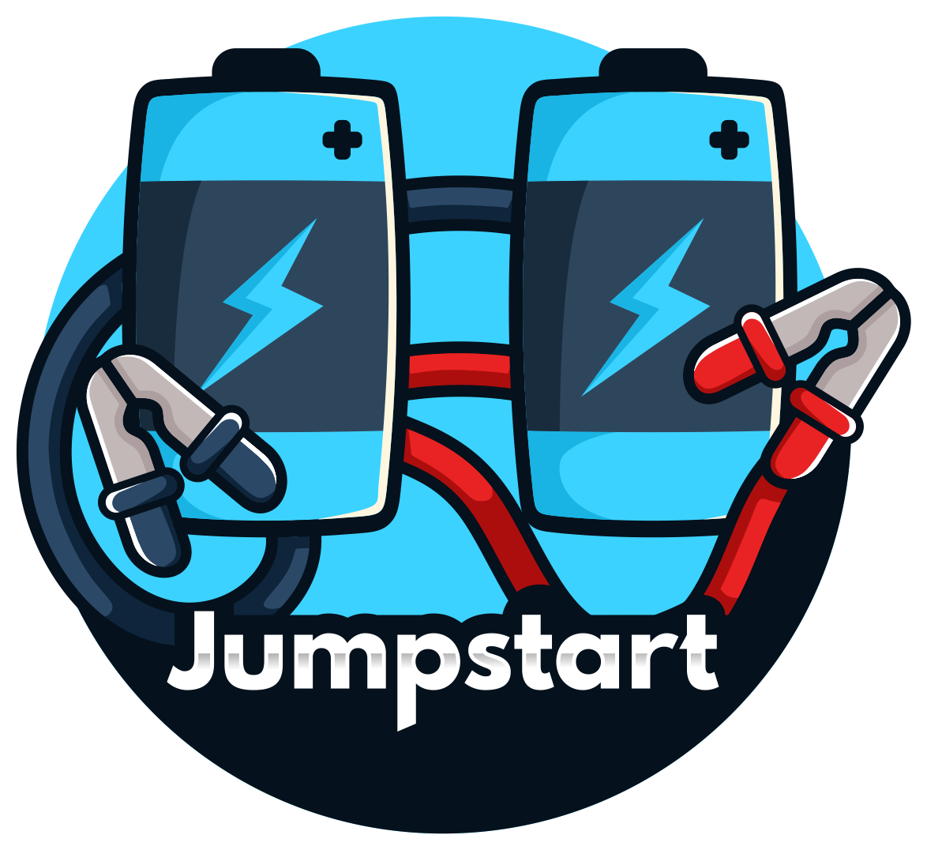
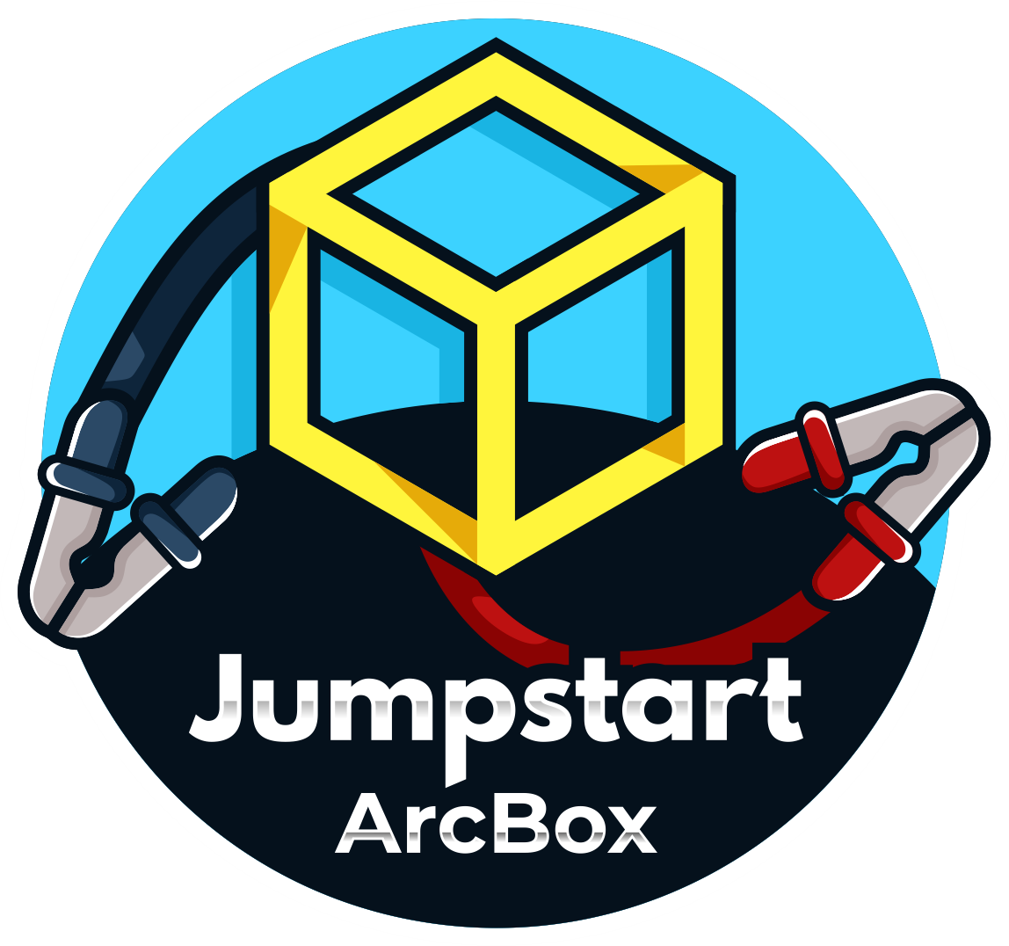

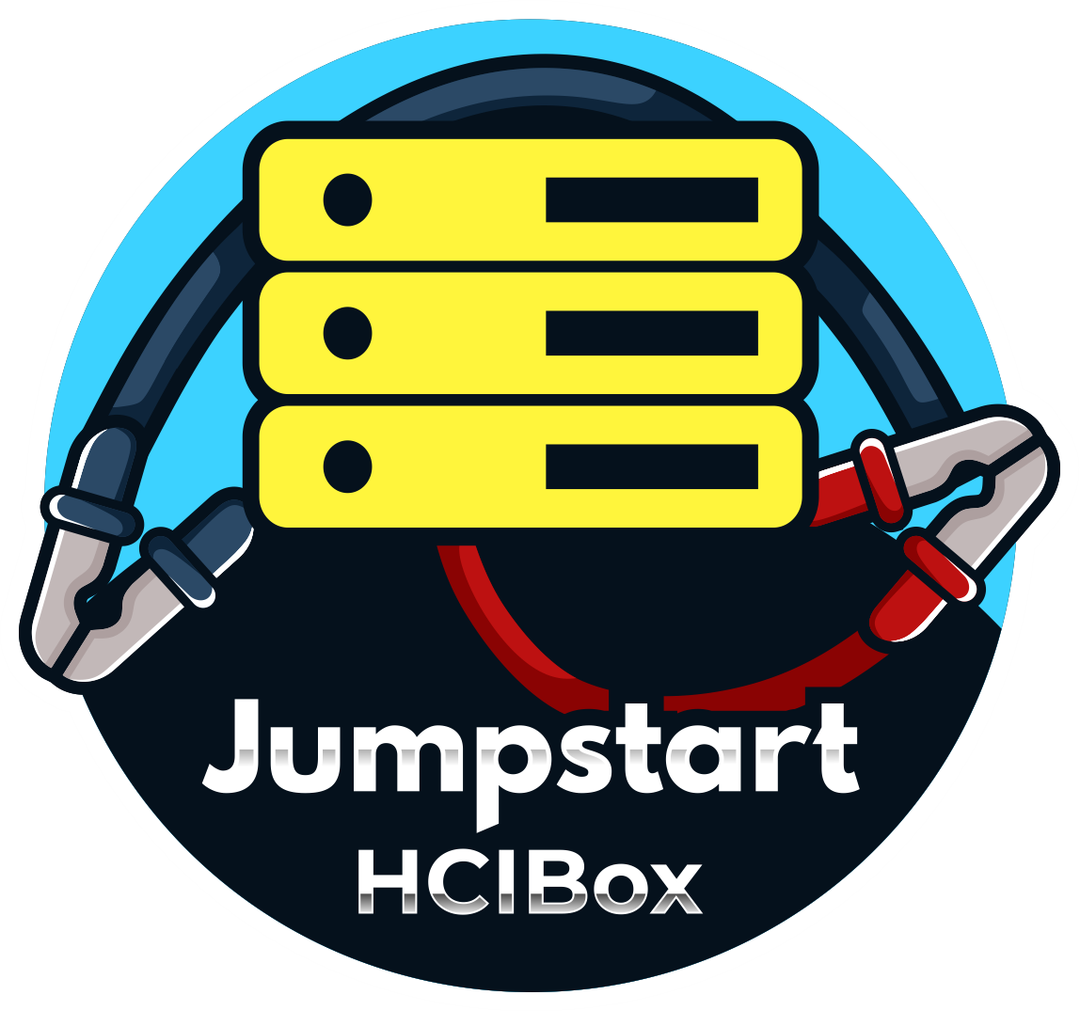
Azure Arc Jumpstart
2022 H2 July – December
2023 H1 January – June
General Availability
122 Azure Arc Jumpstart scenarios | CAPI Kubernetes 1.24 support
ArcBox “Full”
ArcBox for ITPros
ArcBox for DevOps
ArcBox for DataOps – SQL Managed Instance
General Availability
ArcBox for Industries | 140 Azure Arc Jumpstart scenarios
AKS hybrid scenarios – Windows Server | CAPI Kubernetes 1.25 support
AKS hybrid scenarios – Windows IoT | ArcBox Azure portal integration
Jumpstart HCIBox | HCIBox Azure portal integration
Preview
Jumpstart HCIBox | CAPI Kubernetes 1.25 support
ArcBox Azure portal integration

Slide 23











Azure hybrid investments in CY 2023+
Leverage and build on Azure Arc as the management and control plane for hybrid and multi-cloud services
Leverage and build on Azure Arc as the management and control plane for infrastructure, apps and data services
Evolve Kubernetes lifecycle management
Improve efficiencies and compliance for data sovereignty / residency regulatory requirements
Continue to invest in enhancing server management capabilities such as Azure Automanage
Increase overall node count scalability through multi-cluster management
Evolve AKS capabilities to orchestrate containerized workloads with support for additional hypervisors and platforms
Drive industry-leading security and hardening characteristics to support unique customer requirements
Drive advancements in AI/ML including native integration and support
Enhance support for HPC workloads including hybrid mechanisms for caching
Leverage software-defined hyper-converged infrastructure as the core platform architecture to run Azure Arc-enabled services
Implement end to end Microsoft delivered solutions including key edge form factor hardware
Enable advanced hybrid IoT implementation to light up data processing at the edge
Evolve compute support to GPU fractional and alternative compute models (offloads)
Continue to invest in improving disconnected scenarios
Assist in best practices, performance and governance of deployed SQL servers by connecting to Azure.
Run real-time analytics with Synapse link. Reintroduce PostgreSQL for business critical data.

Slide 24
Glossary

Slide 25
Azure Arc-enabled Infrastructure Details (1/4)
Azure Policy for Kubernetes
Azure Policy for Kubernetes makes it possible to manage and report on the compliance state of your Kubernetes clusters from one place.
Kubernetes cluster browsing via Azure Portal
The Azure Portal includes a Kubernetes resource view for easy access to the Kubernetes resources in your Azure Arc-enabled Kubernetes cluster.
Azure Private 5G Core
Azure Private 5G Core Preview is an Azure cloud service for deploying and managing 5G core network functions on an Azure Stack Edge device, as part of an on-premises private mobile network for enterprises.
Azure Arc-enabled Open Service Mesh
Open Service Mesh is a lightweight, extensible, Cloud Native service mesh that allows users to uniformly manage, secure, and get out-of-the-box observability features for highly dynamic microservice environments.
SQL Server health scans
Azure Arc-enabled SQL Servers can have assessments run against them. These assessments evaluate your configuration and highlight potential configuration issues.
Microsoft Defender for SQL Server
Microsoft Defender for SQL Server detects anomalous activities indicating unusual and potentially harmful attempts to access or exploit databases.

Slide 26
Azure Arc-enabled Infrastructure Details (2/4)
Arc-enabled System Center VMM
Arc-enabled System Center VMM enables VM lifecycle management and centralized governance for System Center VMM environments from the Azure Portal.
Update management center for Arc-enabled Servers
Manage operating system updates for your Azure Arc-enabled servers running Windows or Linux with Update Management in Azure Automation.
Azure Container Registry Connected Registry
A Connected Registry is an on-premises or remote replica that synchronizes container images and other OCI artifacts with your cloud-based Azure container registry. Use a connected registry to help speed up access to registry artifacts on-premises.
Azure AD workload identity federation for Kubernetes
With this project, developers can use native Kubernetes service accounts and federation on their Arc-enabled Kubernetes clusters to access Azure AD protected resources.
Kubernetes Namespaces in ARM
Namespaces displays the namespaces of your Arc-enabled Kubernetes cluster in the Azure Portal. A service account token is used for authentication to the cluster.
Arc-enabled VMware vSphere
With Azure Arc-enabled VMware vSphere, you get a consistent management experience across Azure and VMware vSphere infrastructure.

Slide 27
Azure Arc-enabled Infrastructure Details (3/4)
Azure Key Vault secrets provider extension for Kubernetes
This extension provides a way for Kubernetes workloads to access secrets stored remotely in an Azure Key Vault, without the need to store and manage them as Kubernetes secrets.
Microsoft Defender for Containers
Defender for Containers protects your Kubernetes clusters whether they're running on Azure Kubernetes Service, Kubernetes on-prem / IaaS, or Amazon EKS.
Azure Arc Jumpstart scenarios
Azure Arc Jumpstart allows you to quickly deploy and utilize all Arc-enabled services for evaluation and learning purposes. Soon, you’ll be able to discover and deploy these environments directly from the Marketplace.
Arc-enabled VM self-service
Use the Azure portal to provision and manage on-premises Windows and Linux virtual machines (VMs) running on Azure Stack HCI clusters.
Windows Admin Center over Arc
Use Windows Admin Center in Azure, communicating over Azure Arc, to get the familiar functionality of WAC for server and cluster management, directly from the Azure Portal.
Azure Automanage for Arc-enabled Servers
Automanage reduces IT admin OpEx by onboarding to and configuring best practices Azure services. The services are automatically monitored and drift-corrected across the Arc-enabled Server’s entire lifecycle. You can choose to use Azure recommended best practices services or define your own.

Slide 28
Azure Arc-enabled Infrastructure Details (4/4)
Private links in AKS extensions
Enable private link for extensions on Azure Kubernetes Service (AKS)

Slide 29
Azure Arc-enabled Services Details (1/4)
Azure SQL Managed Instances – Business Critical
Business Critical instances are designed for performance-sensitive workloads with higher availability requirements.
Data services: backup/restore
Use the built-in point in time restore (PITR) feature to recover from situations such as data corruptions caused by human errors.
Data services: disaster recovery
Distributed availability groups allow you to create SQL Managed Instances across multiple sites for disaster recovery purposes.
Azure Machine Learning - Inferencing
Azure Arc-enabled machine learning lets you configure and use Azure Kubernetes Service or Azure Arc-enabled Kubernetes clusters to inference and manage machine learning models in Azure Machine Learning.
Azure Machine Learning - Training
Azure Arc-enabled machine learning lets you configure and use Azure Kubernetes Service or Azure Arc-enabled Kubernetes clusters to train and manage machine learning models in Azure Machine Learning.
Data services: Distributed availability groups
The same distributed availability group feature that powers traditional SQL servers comes to Arc-enabled SQL managed instances.

Slide 30
Azure Arc-enabled Services Details (2/4)
PostgreSQL General purpose
PostgreSQL v14​
Single node deployment​
Onboard to Arc-SQL Server during SQL Server 2022 setup​
Basic PostgreSQL authentication​
Active Directory​
Automated single cluster backup and restore​
Top 5 PostgreSQL extension (prioritized by strategic customers)​
No Hyperscale
Portal and CLI​
Configure readable secondaries from portal and Azure data studio​
AD support integration with CLI, Azure data studio​
PostgreSQL consistent support in portal and Arc data studio
PostgreSQL Business critical​
Upgrade to Postgres15​
Availability groups​
Failover groups​
Long term retention of backups​
Azure AD​
Bring your own extension​
Arc SQL MI Observability and insights​
Observability with SQL performance views​
Improved metrics and log​
Integration with 3P tooling
Observability with SQL performance views​
SQL Insights​
Upgrade ​

Slide 31
Azure Arc-enabled Services Details (3/4)
Data services: Active Directory authentication
Arc-enabled SQL Managed Instance can use an existing on-premises Active Directory (AD) domain for identity and access management.
Azure Key Vault client for Data Services
Allows Active Directory enabled SQL Managed Instances to retrieve and store credentials securely.
Azure App Service
Azure App Service is an HTTP-based service for hosting web applications, REST APIs, and mobile back ends. It can be run on any Arc-enabled Kubernetes cluster.
Data services: Evergreen SQL upgrades
Keep your on-premises SQL Managed Instances always up-to-date by enabling automatic upgrades. Works in both Direct and Indirect connectivity modes.
Azure PostgreSQL
Azure PostgreSQL single server platform is designed to handle most of the database management functions such as patching, backups, high availability, security with minimal user configuration and control.
Azure Functions
Azure Functions is a serverless solution that allows you to write less code, maintain less infrastructure, and save on costs. It can be run on any Arc-enabled Kubernetes cluster.

Slide 32
Azure Arc-enabled Services Details (4/4)
Azure Logic Apps
With Azure Arc-enabled Logic Apps, you can create and deploy logic app workflows in the same way as in the single-tenant experience for Azure Logic Apps.
Azure Event Grid
Event Grid is an event broker used to integrate workloads that use event-driven architectures. An event-driven architecture uses events to communicate occurrences in system state changes.
Azure API Management
Deploying the API Management gateway on an Azure Arc-enabled Kubernetes cluster expands API Management support for hybrid and multi-cloud environments.
Azure Arc Jumpstart scenarios
Azure Arc Jumpstart allows you to quickly deploy and utilize all Arc-enabled services for evaluation and learning purposes. Soon, you’ll be able to discover and deploy these environments directly from the Marketplace.

Slide 33
Azure Stack HCI Details (1/5)
Enhanced Azure remote support
Grant consent on an as-required basis for Microsoft support personnel to remotely gather logs and run commands.
OEM Hardware-as-a-Service offerings
Azure Stack HCI Integrated Systems can now be acquired on a service basis from Lenovo TruScale and HPE GreenLake, allowing customers to acquire and scale their edge infrastructure on a true as-a-service basis.
Intent-based network automation with Network ATC
Network ATC provides an intent-based approach to host network deployment. By specifying one or more intents (management, compute, or storage) for a network adapter, you can automate the deployment of the intended configuration.
Custom image upload for VM self-service
Upload custom operating system images to Azure for distribution to your edge sites from a centralized cloud location.
ReFS deduplication
A new deduplication system that integrates seamlessly into ReFS volumes will improve storage efficiency and performance on the live VM workloads hosted on HCI.

Slide 34
Azure Stack HCI Details (2/5)
Azure Migrate from Hyper-V to HCI
Use Azure Migrate tools to migrate VMs from existing Windows Server and Hyper-V Server environments over to Azure Stack HCI, without downtime.
Single-node HCI deployments
Azure Stack HCI can be deployed onto single-node configurations, allowing for lower hardware costs in situations where high-availability is not a requirement
GPU-P with live migration
GPU-P will allow you to partition GPUs between multiple virtual machines and migrate them between hosts in a cluster without losing access to hardware acceleration
Azure Marketplace for VM self-service
Get VM images including Windows 10 Enterprise multi-session and Windows 11 Enterprise multi-session directly from the Azure Marketplace.
​
Trusted launch
Trusted launch protects against advanced and persistent attack techniques. Secure Boot is attested by virtualized TPM (vTPM) with support for live migration without Host Guardian Service.
Azure Virtual Desktop session hosts on HCI
In environments where access to AVD in Azure may not be allowed or does not provide the necessary user experience, AVD session hosts can be hosted locally on Azure Stack HCI.

Slide 35
Azure Stack HCI Details (3/5)
New orchestrated deployment experience
A new deployment experience uses a wizard to gather your inputs into a config file. The config file is consumed by a new orchestration engine that takes care of the end-to-end system deployment. At the end of the deployment, your system is registered with Azure, Arc-enabled, and ready for you to deploy your first workload.
Default security improvements
More than 200 security settings including a stronger set of protocols and cipher suites, limiting the usage of insecure protocols, Secured-Core for Server features, Windows Defender application control and other well-known security features enabled by default right from the start. The new security settings are applied during deployment and will better comply with Microsoft Azure’s latest security baseline and DISA STIG security guidelines. Also included is simpler integration with Microsoft Defender for Cloud.
Environment readiness validators
A new tool designed to validate and diagnose customer environment readiness before, during and after deployment. The public preview will include two key validators: connectivity validator and hardware validator. The connectivity validator will check that each of your cluster nodes can reach the Azure services you plan to use. The hardware validator will ensure all physical nodes are configured uniformly and there is hardware consistency across all the nodes.
There will also be a standalone version available in the PowerShell gallery for customers who want to evaluate the readiness of their environment prior to hardware arrival.​

Slide 36
Azure Stack HCI Details (4/5)
Live migration improvements for switchless interconnects
Switchless deployments are great lower-cost options for retail and fleet scenarios, and now benefit from VM live migration support improvements.
Tag based segmentation for SDN
Secure your application workload virtual machines from external as well as lateral threats with custom tags of your choice. Assign any custom tags to classify your VMs, and then apply Access Control Lists (ACLs) based on the tags to restrict communication to/from external as well as internal sources. For example, to prevent your SQL VMs from communicating with your web server VMs, simply tag corresponding VMs with “SQL” and “Web” tags and create an ACL to prevent “Web” tag from communicating with “SQL” tag.
Increased diagnosability
Optionally let Microsoft proactively collect periodic support data and telemetry with privacy settings in the new deployment experience. You can gather diagnostics logs using PowerShell and send them to Microsoft to assist with troubleshooting and mitigation. You can also view log collection history using PowerShell.
Windows Server 2022 Datacenter Azure Edition on Azure Stack HCI
The preview of Marketplace VM images will let customers deploy Windows Server Azure Edition (already generally available in Azure IaaS) on Azure Stack HCI as a preview experience. This enables unique features like Hotpatch and SMB over QUIC on Windows Server Azure Edition VMs on Azure Stack HCI. Through future guest management extensions, the full Azure Automanage experience will also become available. The ability to run Windows Server Azure Edition on Azure Stack HCI is one of several Azure Benefits, like free Extended Security Updates.

Slide 37
Azure Stack HCI Details (5/5)
Arc-enabled guest management
Azure Arc-enabled guest management. Another big preview integration that we are bringing to Arc VMs on Azure Stack HCI is the ability to enable Arc guest management when a VM is created. Guest management is an enabler for several VM extensions such as custom script and domain join. This is just the beginning, and we will add support for more extensions to bring governance, monitoring, update management and security at scale using rich Azure management services like Azure Monitor, Defender for Cloud, and more.
AD-less live migration
Customers can Live Migrate VMs without Active Directory dependencies.
Enhanced monitoring
Recent updates to HCI Insights in Azure Monitor bring enhanced single-cluster and multi-cluster views to view infrastructure health, performance and usage for servers, virtual machines and storage. The new dashboard views are built with Azure Workbooks which are fully customizable to meet your specific monitoring needs.
Easier proxy config
Customers can easily configure network proxy (WinHttpProxy).

Slide 38
Azure Kubernetes Service (1/2)
Horizontal autoscale support
The cluster autoscaler scales up when pods can't be scheduled on nodes because of resource constraints. The cluster autoscaler also decreases the number of nodes (scaled down) when there has been unused capacity for a period of time. The preview release is PowerShell only to enable the autoscaler and to manage automatic scaling parameters like time intervals between scale events and resource thresholds.
Vertical scaling support
Add more memory or CPU to AKS clusters on Azure Stack HCI or Windows Server by changing the virtual machine (VM) size (SKU) of the VMs in each node pool. Without vertical node scaling, you would need to redeploy to a new node pool and move the app.
Proxy support improvements
Proxy is common in many of our enterprise customer environments, so we spent time making sure that AKS on Azure Stack HCI and Windows Server supports authenticated proxy and accesses as few network endpoints (URLs) as possible so it’s easier to add required ports and URLs to proxy/firewall allow lists.
Windows Server 2022 containers support
Windows Server 2022 provides optimized base images (the server core image has its size reduced by 33%) to support windows server apps that require libraries not found in ‘server core’, plus numerous networking performance improvements and new functionality such as direct Server Return (DSR) to improve networking latency.

Slide 39
Azure Kubernetes Service (2/2)
Workload cluster lifecycle management for AKS on-prem
This capability enables the creation and lifecycle management of workload clusters on AKS on-premises, directly from the Azure Portal or using Az CLI.
Reduced system requirements for AKS
AKS is fully supported on a single Windows Server machine with 64BG+ RAM and a 200GB+ SSD. This allows customers with existing hardware or low-cost hardware.
GPU support in AKS
AKS on Azure Stack HCI and Windows Server can pass the GPU through to Kubernetes workloads for some kinds of host hardware. This makes it possible to run AI/ML workloads in a containerized environment.
SDN support in AKS
SDN support uses the Software Defined Load Balancer (SLB) to manage load-balancing network traffic for containers the way it would for VMs running on Azure Stack HCI.

Slide 40
Appendix

Slide 41
Azure Arc use cases

Slide 42

How it works: Accelerate and scale innovation
5
2
4
1
3
Collaboration
DevOps
Local app + data
Instrument telemetry
Operations
Azure Arc
VS Code
GitHub
GitHub Actions
GitOps
Azure SQL MI
K8s/AKS
VMware/HCI
Monitor
Azure ML
App Insights
Policy
Defender
Sentinel
Example: Clinical analytics
Notes:
Smart city, w/ local, low-latency processing for image recognition

Slide 43
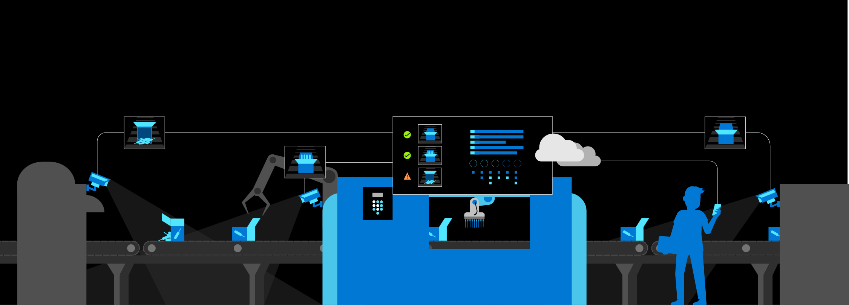
How it works: Improve operational efficiency
4
3
1
2
5
IoT Devices
Inferencing
Edge Processing
Training
Operations
Azure Arc
IoT Edge
Azure ML
Azure SQL MI
AKS
HCI
Azure ML
IoT Hub
Defender
Policy
Example: predicative maintenance for manufacturing
Notes:
Smart city, w/ local, low-latency processing for image recognition

Slide 44

How it works: Secure and govern digital estate
4
5
1
3
2
Onboard to Azure
Organize & Inventory
Configure & Deploy
Monitoring
Secure and Govern
Azure Arc
Windows
Linux
Kubernetes
IoT devices
ARM
Resource Graph
Lighthouse
Policy
Automation
AKS
HCI
Monitor
App Insights
GitHub Actions
Policy
Defender
Sentinel
Example: Intelligent retail
Notes:
Smart city, w/ local, low-latency processing for image recognition

Slide 45

How it works: Meet custom latency and sovereignty requirements
1
3
5
2
4
Develop and Deploy
Edge Intelligence
Low Latency
Monitor
Secure and Govern
Azure Arc
VS Code
GitHub Actions
GitOps
Cognitive Services
Azure ML
5G MEC
AKS
HCI
Monitor
App Insights
Policy
Defender
Sentinel
Example: Smart city crosswalks
Notes:
Smart city, w/ local, low-latency processing for image recognition

